Slide 1
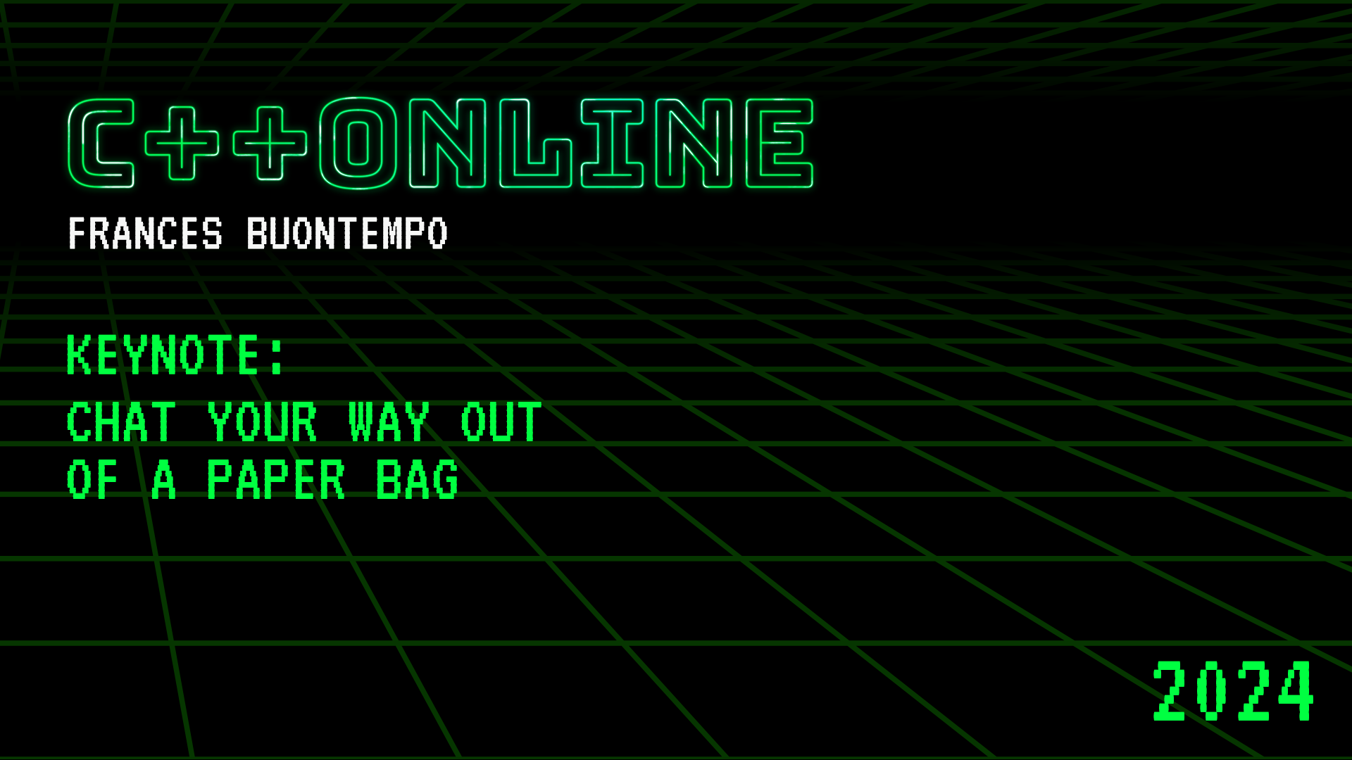

Slide 2
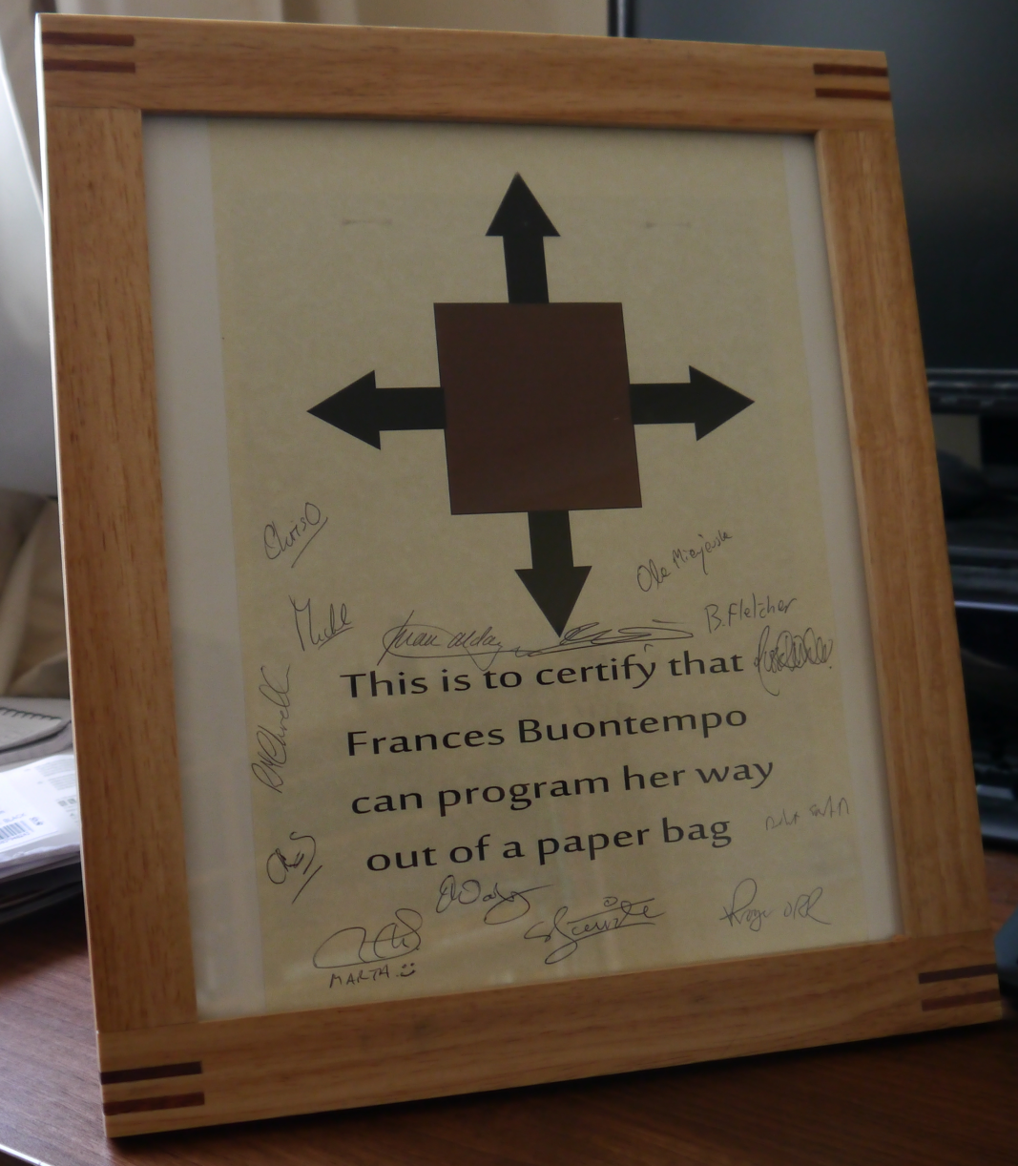
Code your way out of a paper bag

Slide 3
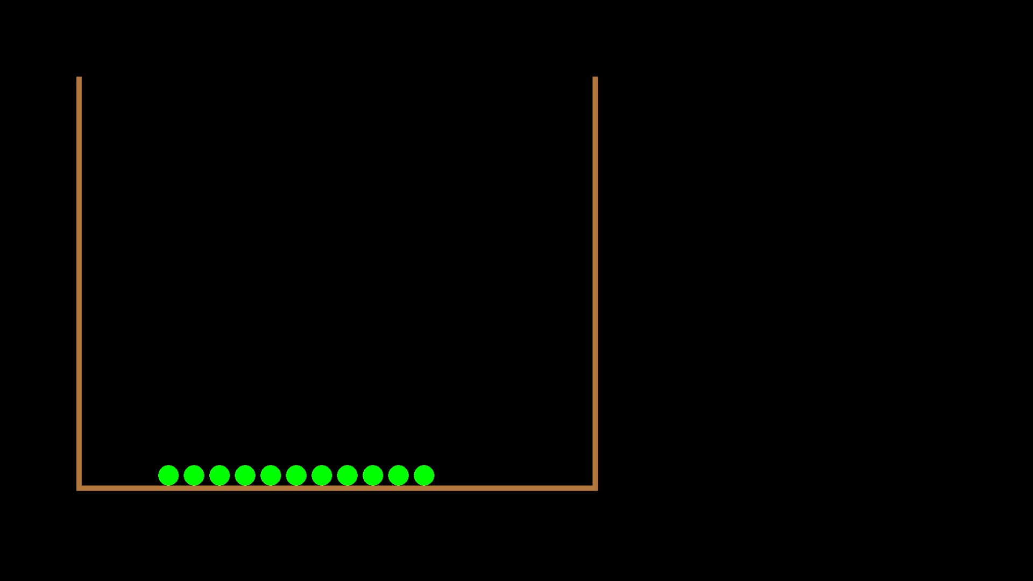
Notes:
Race\Debug\SFMLRace.exe s

Slide 4
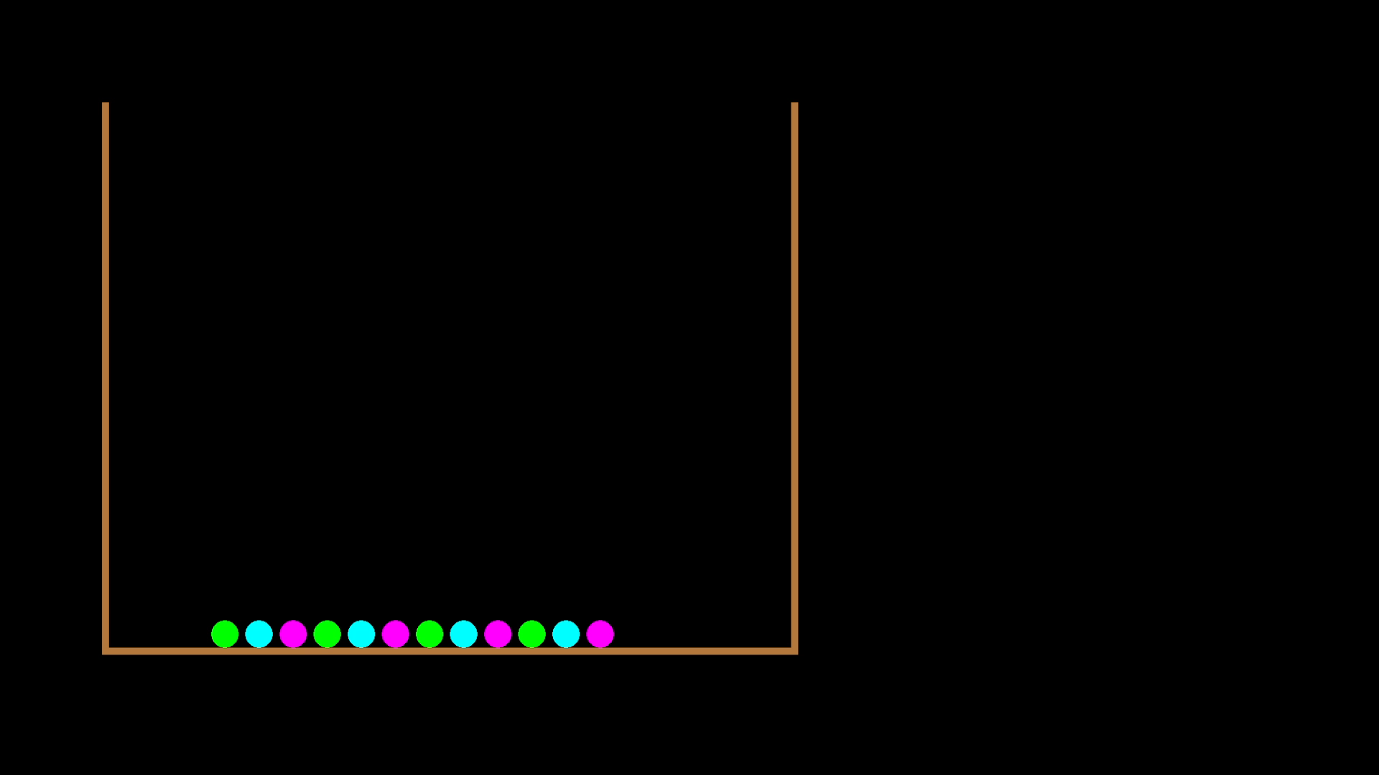

Slide 5
Keep on learning
Personal projects are good
Code your way out of a paper bag
https://www.youtube.com/results?search_query=frances+buontempo
An underspecified problem
Which is a good thing for learning
Can AI code it’s way out of a paper bag?
We shall see

Slide 6


Slide 7
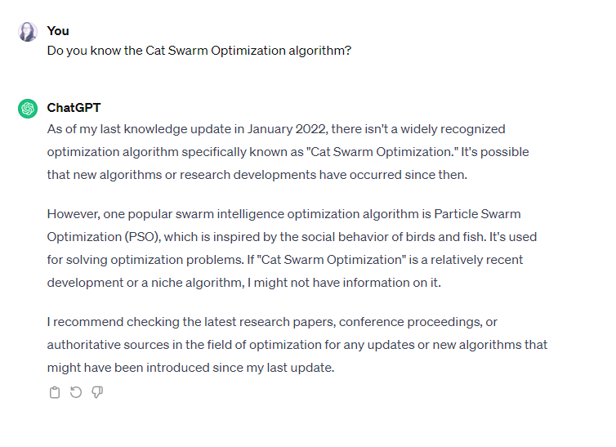
Chat your way out of a paper bag
Notes:
https://link.springer.com/chapter/10.1007/978-3-540-36668-3_94 says 2006

Slide 8
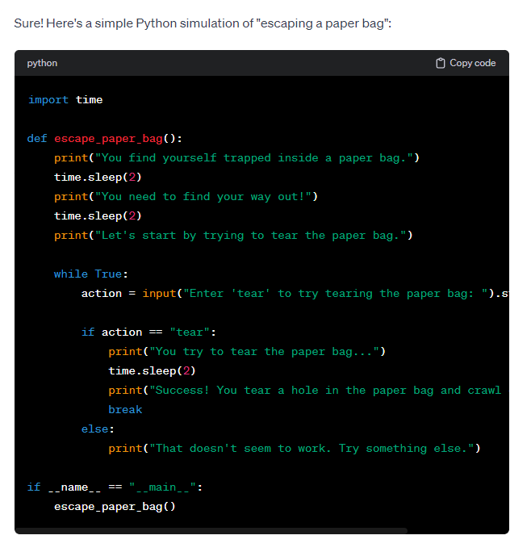
Notes:
action = input("Enter 'tear' to try tearing the paper bag: ").strip().lower()
print("Success! You tear a hole in the paper bag and crawl out to freedom!")

Slide 9
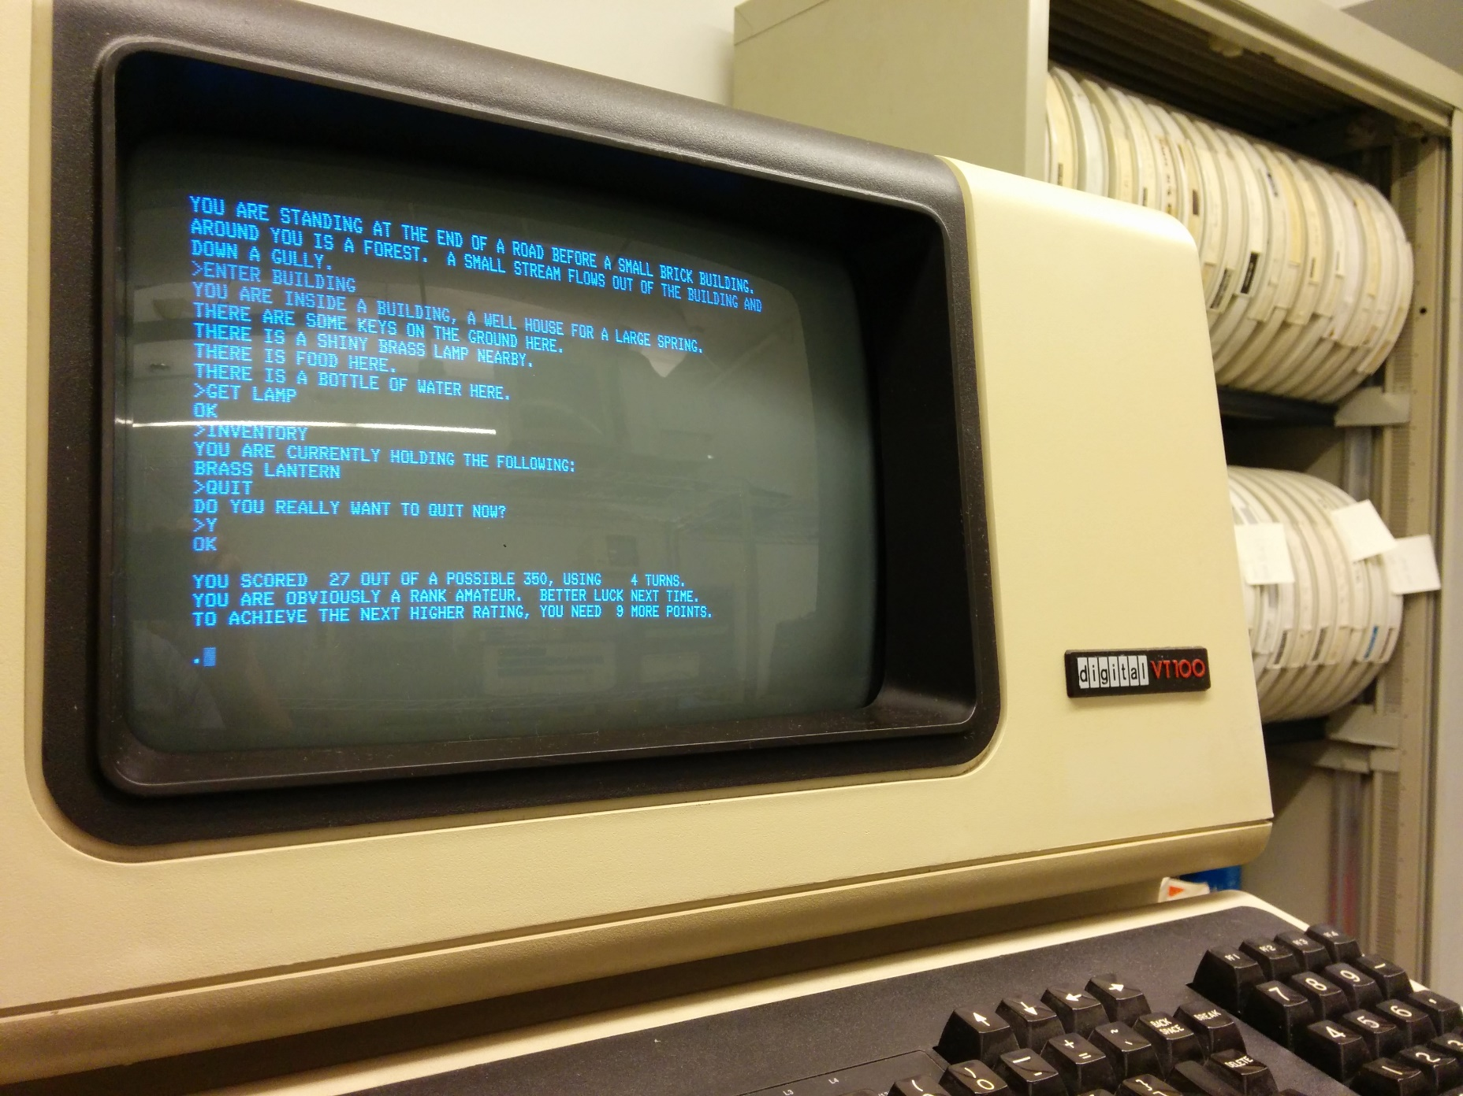
By Autopilot - Own work, CC BY-SA 3.0, https://commons.wikimedia.org/w/index.php?curid=33164592

Slide 10

HHGTTG
“Oh God,” muttered Ford, slumped against a bulkhead and started to count to ten.
He was desperately worried that one day sentient life forms would forget how to do this.
Only by counting could humans demonstrate their independence of computers.

Slide 11
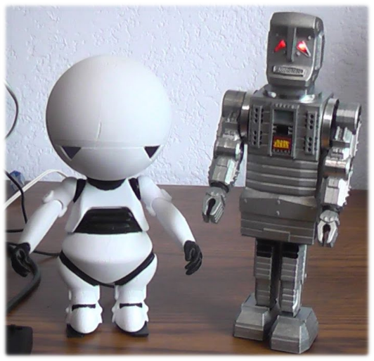
Marvin
Now the world has gone to bed, Darkness don't engulf my head, I can see by infrared, How I hate the night. He paused to gather artistic and emotional strength to tackle the next verse. Now I lay me down to sleep, Try to count electric sheep, Sweet dream wishes you can keep, How I hate the night.

Slide 12
Is ChatGPT intelligent?
The Turing test
The Imitation Game ducks the question of whether machines can think
https://plato.stanford.edu/entries/turing-test/
Test: Can you spot which is the human and which is the machine?
Turing expected in 50 years we’d “not have more than 70 percent chance of making the right identification after five minutes of questioning”
Do you recognise ChatGPT generated content?

Slide 13
Ascribing Mental Qualities to Machines
“Machines as simple as thermostats can be said to have beliefs, and having beliefs seems to be a characteristic of most machines capable of problem-solving performance.”
John McCarthy 1979
John Searle responded in 1980 with his Chinese Room Argument: “the implementation of the computer program is not by itself sufficient for consciousness or intentionality”
https://plato.stanford.edu/ENTRIES/chinese-room/

Slide 14
Can AI replace help programmers?

Slide 15
Yes
But…

Slide 16
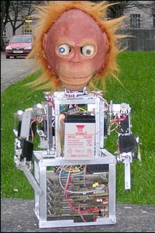
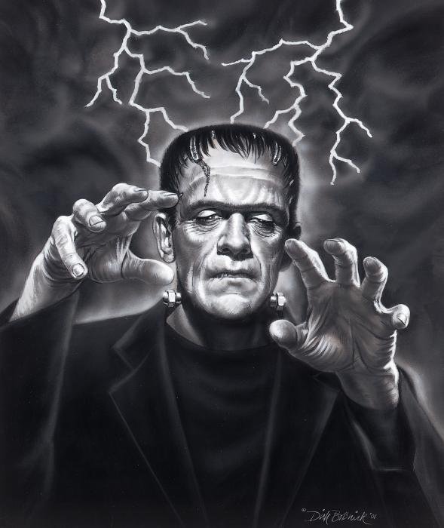
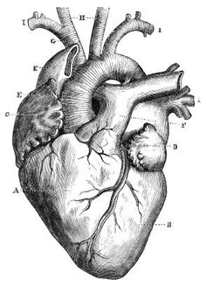

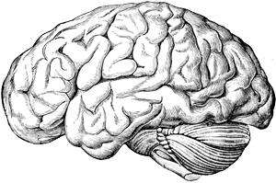

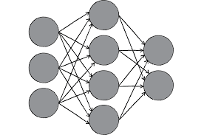
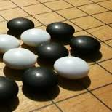

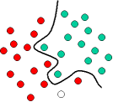
What is AI?
“Reproduce human intelligence electronically”
John McCarthy in 1955
Notes:
http://computerju.com/Materials/AI/Luger-Artificial%20Intelligence-5th%20ed.pdf

Slide 17
Various types of AI
Robots
Machine learning
Data science/analysis
Nature inspired algorithms
Chat bots
Automated
Augmented
Predictive text, IntelliSense
Code auto-generation, frameworks, copilots,…

Slide 18
What is Machine Learning?
Arthur Samuel coined the term in 1959:
Machine learning is a
"Field of study that gives computers the ability to learn without being explicitly programmed"
Notes:
Picture https://en.wikipedia.org/wiki/Draughts#Computer_draughts quoted words: https://en.wikipedia.org/wiki/Arthur_Samuel

Slide 19
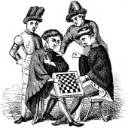
Playing Games
Samuel believed “teaching computers to play games was very fruitful for developing tactics appropriate to general problems”
Use a scoring function (feedback) to choose moves, and this can change over time (iteration)

Slide 20

Draughts, Chess, Go,…
Brute force examining all (or most) possible moves
What if there are 10¹⁷⁰ possible moves?
Alpha Go “learnt by playing against itself, starting from completely random play”
https://deepmind.com/research/case-studies/alphago-the-story-so-far

Slide 21
What is (most) AI?
While not Done
Try a few things at random
Possibly using a heuristic
Test these
Remember the better things

Slide 22
augment
automate
Computers
helping
people
Computers
replacing
people

Slide 23
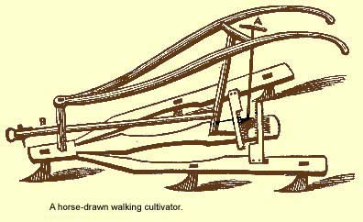
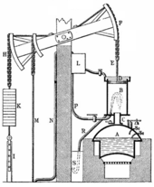
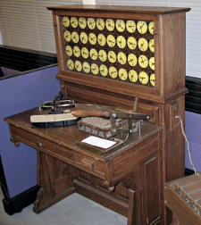
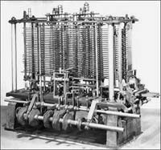
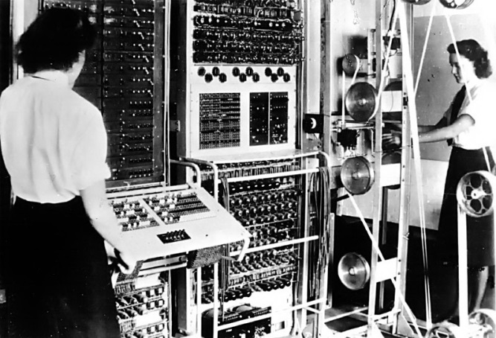
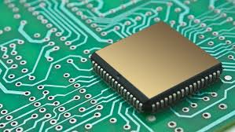
Automate everything!
Machine for one task -> general purpose
Faster -> smarter
Automatic != intelligence
Notes:
https://www.theguardian.com/technology/2016/mar/28/tay-bot-microsoft-ai-women-siri-her-ex-machina Leibniz’ wheel: http://computerju.com/Materials/AI/Luger-Artificial%20Intelligence-5th%20ed.pdf

Slide 24
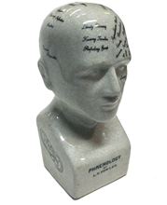
Automate everything?
Chat bots; remember Tay?
“AI systems feed off of both positive and negative interactions with people.”
Prisoner sentence length
“… several statistical and technical errors such as mis-specified regression models, mis-defined classification terms and measures of discrimination, the incorrect interpretation and use of model errors, ...”
Automated inference on criminality using face images
“discriminating structural features for predicting criminality”
Pictures
Gorilla blunder
Words
father: doctor, mother: nurse,
man: computer programmer, woman: home-maker
Notes:
Tay http://blogs.microsoft.com/blog/2016/03/25/learning-tays-introduction
Gorillas: http://www.bbc.co.uk/news/technology-33347866
Prisoner sentence length http://www.northpointeinc.com/northpointe-analysis
Criminality in faces https://arxiv.org/abs/1611.04135
https://smerity.com/articles/2016/algorithms_can_be_prejudiced.html

Slide 25
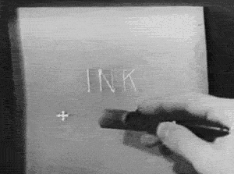
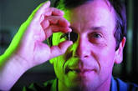
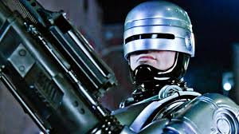
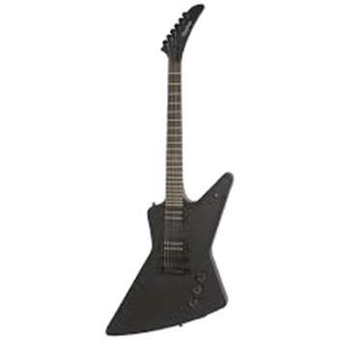
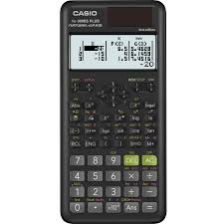

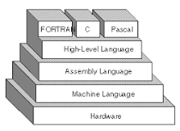
Augment everything

Slide 26
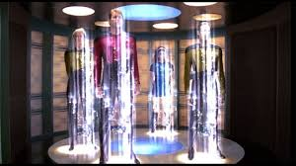
Automation is useful … But isn’t AI
Automatic doors
CI, deployment scripts, …
Wizards, frameworks
Intellisense
Automatic formatters
ORM libraries
Compilers
Programmers rely on their computers
to do a lot of work for them already

Slide 27
If you automate what you do now, will anything ever change?

Slide 28
Augment == Help?!
Books
The internet
StackOverflow
ChatGPT
Copilot

Slide 29
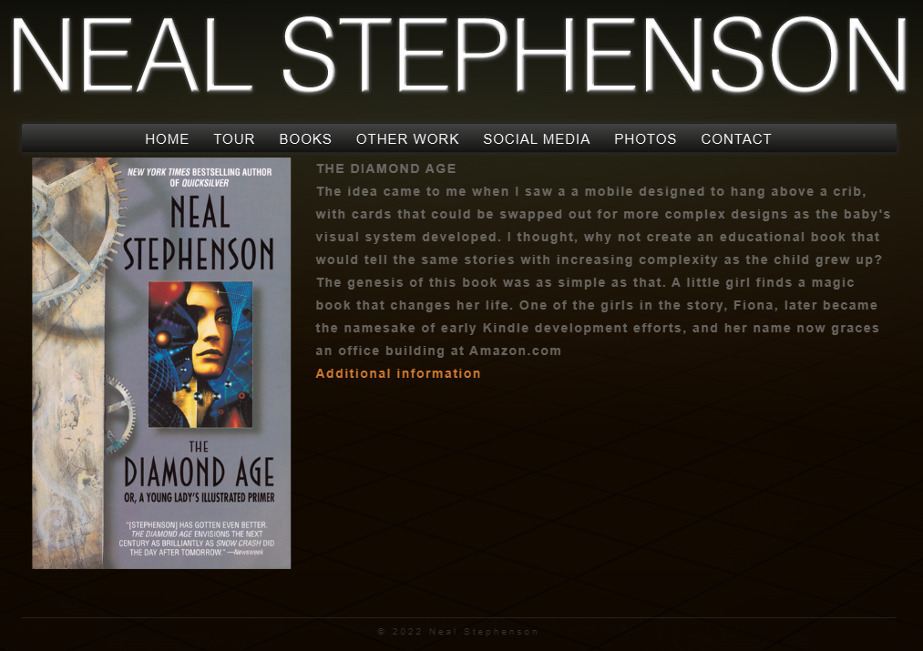
This is not the AI I was dreaming of

Slide 30
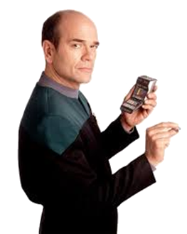
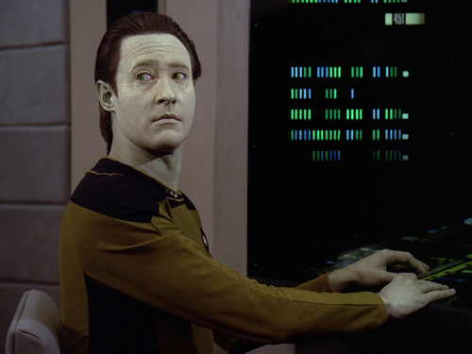
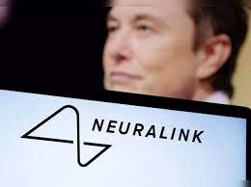
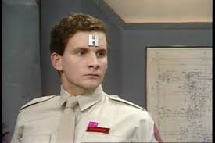
Hardware
Does AI need a “physical body”?
Morphological computation
is thought independent of the body?
Could a person exist in “cyberspace”?
SciFi; whole brain emulation, mind uploading, …
Notes:
https://en.wikipedia.org/wiki/Mind_uploading_in_fiction
Morphological computation is a design approach, often used in robotics, that considers the body of a robot vital for any intelligent behaviour
Sensors needed… http://www.bristol.ac.uk/news/2017/march/leverhulme-trust-research-project-grant.html
Pfeifer and Bongard “How the body shapes the way we think” . Try to show “ thought is not independent of the body but is tightly constrained, and at the same time enabled”

Slide 31
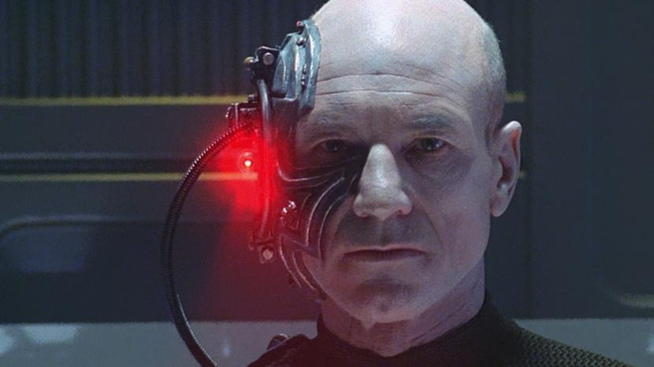
“I am Locutus, of Borg. Resistance... is futile. Your life as it has been is over.”
Notes:
https://intl.startrek.com/article/are-we-borg

Slide 32
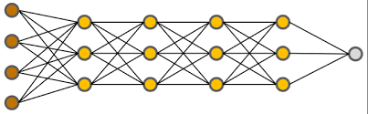
Build a brain and it will think
Do artificial neural networks think or learn?
Could they pass the Turing test?
How many cat and dog images do they need as training data?
Do they enjoy playing Go?

Slide 33
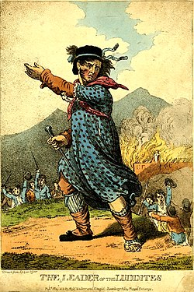
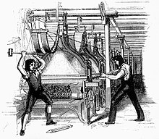
Can AI (or machines) replace people?
The Luddites were “protesting against the use of machinery in a "fraudulent and deceitful manner" to get around standard labour practices”

Slide 34
Can AI replace programmers?
Can AI code?
Can a machine generate code for Fizz Buzz?
Let’s see…

Slide 35
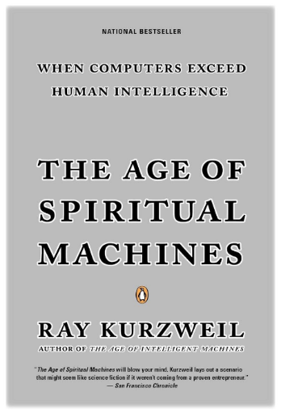
Recursion, neural nets and genetic algorithms are all components of intelligent machines
https://en.wikipedia.org/wiki/The_Age_of_Spiritual_Machines

Slide 36
Augmented Fizz Buzz
def fizz_buzz(n):
"""
Returns 'Fizz' if n is divisible by 3,
'Buzz' if n is divisible by 5,
'FizzBuzz' if n is divisible by both 3 and 5,
otherwise returns the number itself.
"""
if n % 3 == 0 and n % 5 == 0:
return "FizzBuzz"
elif n % 3 == 0:
return "Fizz"
elif n % 5 == 0:
return "Buzz"
else:
return n
import unittest
class TestFizzBuzz(unittest.TestCase):
def test_fizz_buzz(self):
self.assertEqual(fizz_buzz(3), "Fizz")
self.assertEqual(fizz_buzz(5), "Buzz")
self.assertEqual(fizz_buzz(15), "FizzBuzz")
self.assertEqual(fizz_buzz(7), 7)
if __name__ == "__main__":
unittest.main()

Slide 37
#include <iostream>
#include <string>
#include <gtest/gtest.h>
std::string fizzBuzz(int n) {
if (n % 3 == 0 && n % 5 == 0) {
return "FizzBuzz";
} else if (n % 3 == 0) {
return "Fizz";
} else if (n % 5 == 0) {
return "Buzz";
} else {
return std::to_string(n);
}
}
int main(int argc, char **argv) {
testing::InitGoogleTest(&argc,
argv);
return RUN_ALL_TESTS();
}
TEST(FizzBuzzTest, DivisibleByThree) {
EXPECT_EQ(fizzBuzz(3), "Fizz");
EXPECT_EQ(fizzBuzz(6), "Fizz");
EXPECT_EQ(fizzBuzz(9), "Fizz");
}
TEST(FizzBuzzTest, DivisibleByFive) {
EXPECT_EQ(fizzBuzz(5), "Buzz");
EXPECT_EQ(fizzBuzz(10), "Buzz");
EXPECT_EQ(fizzBuzz(20), "Buzz");
}
TEST(FizzBuzzTest,
DivisibleByBothThreeAndFive) {
EXPECT_EQ(fizzBuzz(15), "FizzBuzz");
EXPECT_EQ(fizzBuzz(30), "FizzBuzz");
EXPECT_EQ(fizzBuzz(45), "FizzBuzz");
}
TEST(FizzBuzzTest,
NotDivisibleByThreeOrFive) {
EXPECT_EQ(fizzBuzz(7), "7");
EXPECT_EQ(fizzBuzz(11), "11");
EXPECT_EQ(fizzBuzz(19), "19");
}

Slide 38
LLMs
Generative pre-trained transformer (GPT)
Train (foundational model):
Tokenization text/image/music -> encoder -> attention -> activation (e.g. softmax to get a probability)
Fine tune model, e.g. supervised and reinforcement training to follow tasks
Use/generate:
Find k nearest embeddings (by cosine similarity) and decode
Retrieval-augmented generations (RAG)
Notes:
“LLMs slow training and inference, extensive hardware requirements, and high running costs.“ A Comprehensive Overview of Large Language Models, 2023 https://arxiv.org/abs/2307.06435
Some maths example/walk through hereL https://osanseviero.github.io/hackerllama/blog/posts/random_transformer/

Slide 39

https://jalammar.github.io/illustrated-transformer/

Slide 40
Text based alternatives
Predictive text
Predictive Intellisense
BAYOU a “a smarter version of the kind of code-completion that's supported by IDEs”
Uses deep learning to write Java for programmers
https://www.theregister.com/2018/04/26/java_coding_automation_deep_learning_ai/
Based on 2018 paper "Neural Sketch Learning for Conditional Program Generation“
“conditional program generation … the generated programs must satisfy a rich set of syntactic and semantic constraints”
Notes:
https://devblogs.microsoft.com/cppblog/c-intellisense-improvements-predictive-intellisense-filtering/

Slide 41
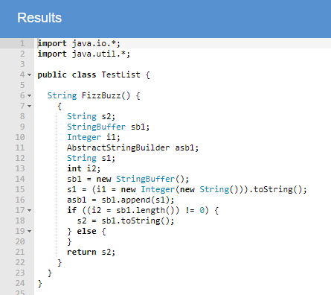

Slide 42
AI (?) FizzBuzz
Using genetic programming to generate a syntax tree for a language.
Based on genetic algorithms, which finds an optimal list/array of values.
Find several randomly
Test them
Pick a few better ones, and form new arrays
Maybe mutate a few values
Iterate

Slide 43
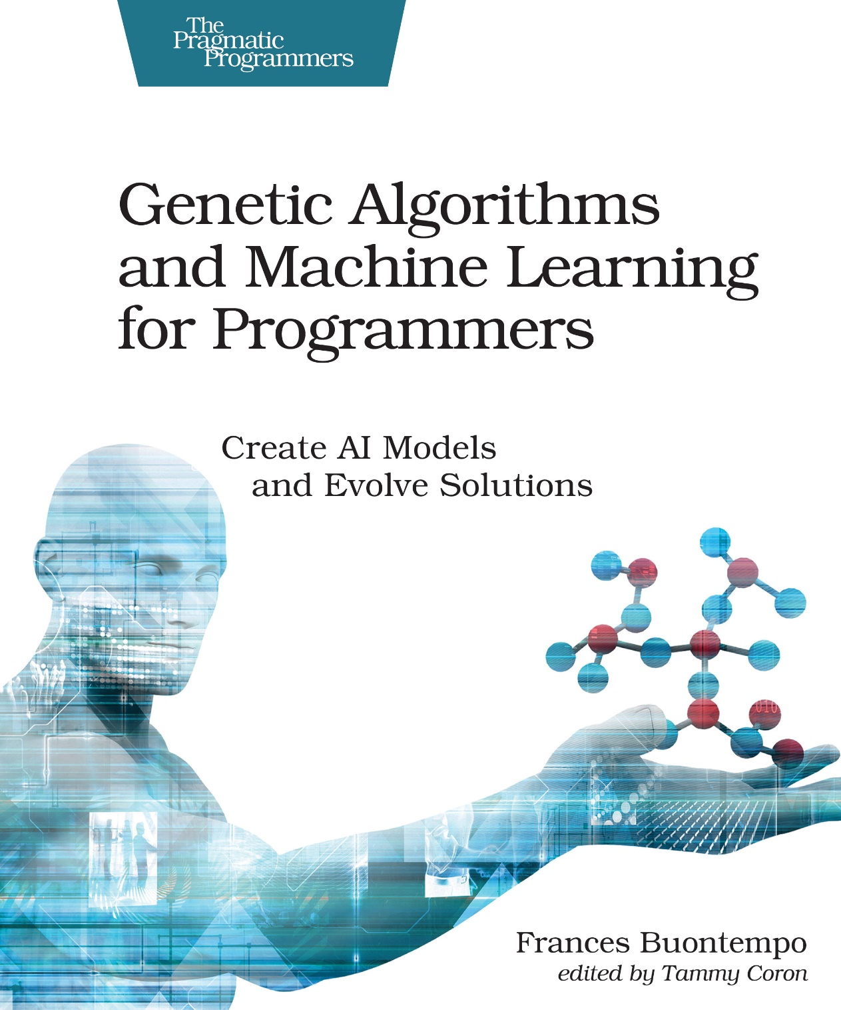

Slide 44
Can you code your way out of a paper bag?
Use heuristics and design fitness functions.
Build genetic algorithms.
Make nature-inspired swarms with ants, bees and particles.
Create Monte Carlo simulations.
Investigate cellular automata.
Find minima and maxima, using hill climbing and simulated annealing.

Slide 45
Genetic algorithms
Evolution:
Driven by a feedback mechanism caused by the success or otherwise in surviving and reproducing;
and modifications of behaviour over a lifetime in response to experience.
https://en.wikipedia.org/wiki/Cybernetics:_Or_Control_and_Communication_in_the_Animal_and_the_Machine
Notes:
https://en.wikipedia.org/wiki/Cybernetics:_Or_Control_and_Communication_in_the_Animal_and_the_Machine

Slide 46
What is a genetic algorithm?
Generate some random arrays
While not Done
Test these
Choose some better ones
and create new arrays by crossover
Maybe mutate a few arrays a bit

Slide 47






Crossover
Mutation
parent
offspring
parents
offspring

Slide 48
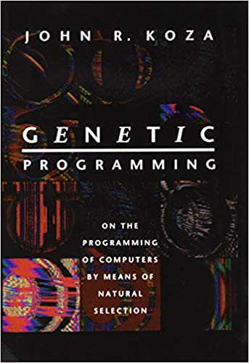
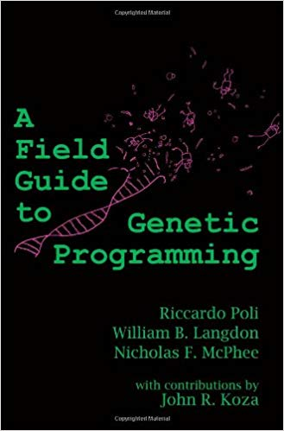
Genetic Programming (GP)-evolution of a tree structure
Evolves the ‘innards’ (white box) of a function or expression
Each tree node is an operator or variable,
or a terminal node.
Used widely to evolve functions for
Curve fitting
Circuit board design
Data modelling
Symbolic regression
Feature selection
Classification
https://en.wikipedia.org/wiki/Genetic_programming#/
media/File:Genetic_Program_Tree.png

Slide 49
What is genetic programming?
Generate some random trees
While not Done
Test these
Choose some better ones
and create new trees by crossover
Maybe mutate a few trees a bit

Slide 50
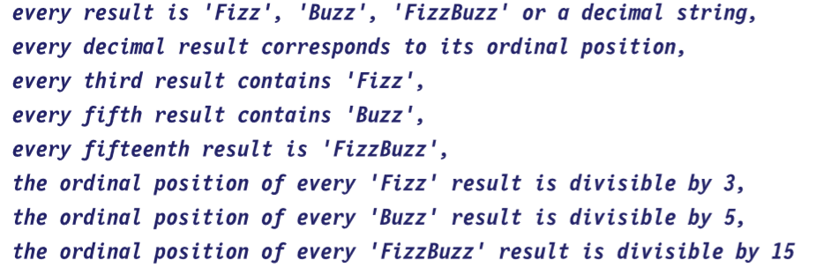
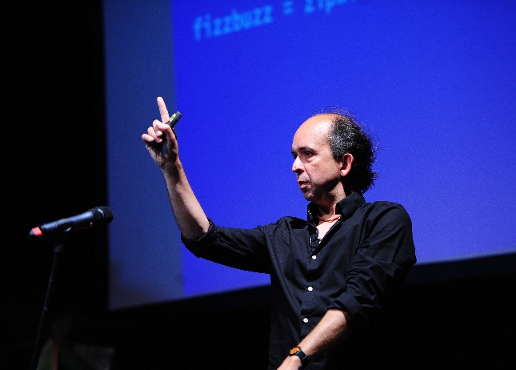

Slide 51
These tests are feedback for AI

Slide 52
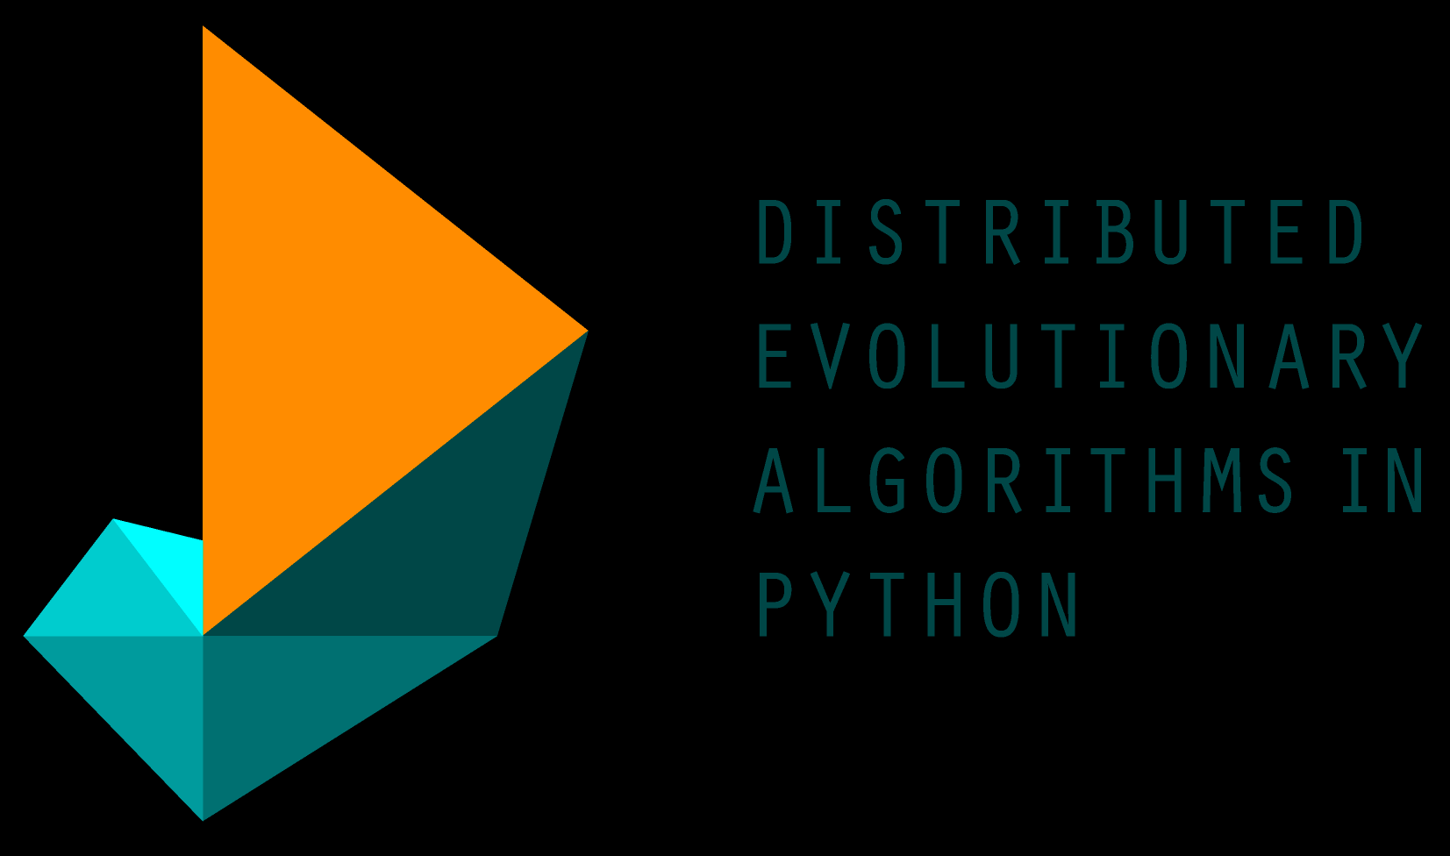
DEAP https://github.com/DEAP/deap
Have to choose operators/functions
Choose parameters
How many trees
How often it recombines
How often it mutates
It keeps track of the best
AKA the Hall of Fame
It took days to get 100% test passes!

Slide 53
The Hof
if_then_else(mod15(if_then_else(if_then_else(mul(x, 'FizzBuzz'), 'Fizz', 'Buzz'), x, if_then_else('Buzz', 'FizzBuzz', mod3(x)))), 'FizzBuzz', if_then_else(both(if_then_else(if_then_else(mod15(x), either('FizzBuzz', 'FizzBuzz'), 'FizzBuzz'), if_then_else('FizzBuzz', mod15(mod5(x)), 'Buzz'), 'Buzz'), if_then_else('Fizz', 'Buzz', if_then_else('FizzBuzz', if_then_else(if_then_else('Buzz', if_then_else(if_then_else(mod3(x), x, 'FizzBuzz'), if_then_else(x, x, either('Buzz', 'Buzz')), x), 'Fizz'), 'Fizz', x), if_then_else(either(if_then_else(x, x, mod3(x)), 'FizzBuzz'), 'Fizz', 'Fizz')))), if_then_else(mod15(x), either('FizzBuzz', either('Buzz', x)), if_then_else(mod3(x), 'Fizz', x)), 'Buzz'))

Slide 54
Writing the tests is hard
Tests, AKA fitness or objective functions in machine learning, are
vital
hard to write
forming an necessary and sufficient set up front is hard
Having a human in the loop to allow iteration, refinement and change is an alternative

Slide 55
AST and code generation
DEAP didn’t use the AST
Using LLVM-based JIT Compilation in Genetic Programming
https://arxiv.org/pdf/1701.05730.pdf
Metaprogramming in .Net by Hazzard and Bock 2012
https://www.manning.com/books/metaprogramming-in-dot-net?
See chapter 6 (6.4 Evolving expression trees) for example of GP
Code tends to be bloated and hard to read

Slide 56
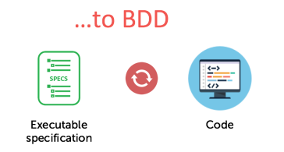
But…
ChatGPT can generate the tests for me
Can copilot et al pass BDD style tests?
https://cucumber.io/blog/bdd/getting-started-with-bdd-part-1/

Slide 57
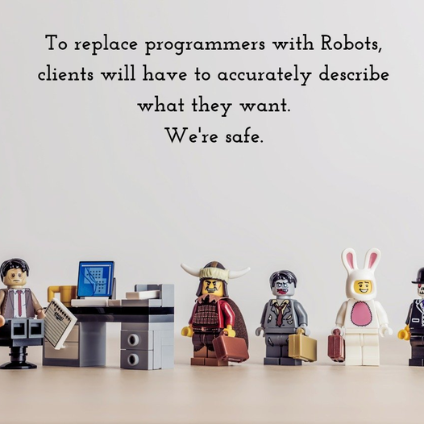

Slide 58
But…
Have you heard of GP?
Or used it?
What about ChatGPT or Copilot et al?
Chat interface is easy to use.
 | Readable code | Working code
GP | ✗ | ✓
LLM | ✓ | ✗

Slide 59
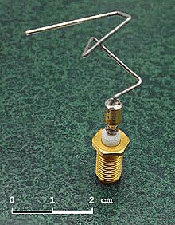

Also,…
GAs can “innovate”
https://en.wikipedia.org/wiki/Genetic_algorithm
LLMs “parrot”
https://en.wikipedia.org/wiki/Stochastic_parrot

Slide 60
And previously, … LISP
“Recursive Functions of Symbolic Expressions and Their Computation by Machine, Part I” John McCarthy, 1961
https://dl.acm.org/doi/10.1145/367177.367199
Homoiconic
meta-programming
a program written in it can be manipulated as data using the language
“a term surrounded by much confusion”
https://www.expressionsofchange.org/dont-say-homoiconic/
Garbage collection
Notes:
https://en.wikipedia.org/wiki/Homoiconicity

Slide 61
To what end?
augment
automate
Computers
helping
people
Computers
replacing
people
Purpose:
Keep asking, “Why?”

Slide 62

We are Borg
Cybernetics = steersman
Κυβερνητικός
Good at steering, good pilot
Notes:
https://intl.startrek.com/article/are-we-borg

Slide 63





AI for accessibility
Notes:
https://www.microsoft.com/en-us/ai/ai-for-accessibility-projects?activetab=pivot1%3aprimaryr2

Slide 64

Testing, testing …
Mutation testing
Change the code to find tests that still pass
Property based testing
State properties rather than magic numbers
Fuzzers
Try random inputs

Slide 65

What is AI?
Almost Implemented
The AI effect:
As soon as AI successfully solves a problem,
the problem is no longer a part of AI
Expert Systems
AI “winter”
Chatbots
Games
Notes:
https://courses.cs.washington.edu/courses/csep590/06au/projects/history-ai.pdf
https://en.wikipedia.org/wiki/AI_effect

Slide 66

Can AI replace programmers?
Yes, but…
Languages,
AI frameworks,
Parameters,
Provide feedback,
Steer,
Tune the tests…
Humans in the loop

Slide 67
So what (next)?
LLMs are a fad (but fun)
Automated Theorem Provers (ATPs) and Interactive Theorem Provers (ITPs) AKA “proof-assistants”
https://arxiv.org/pdf/1912.03028.pdf#:~:text=Theorem%20provers%20are%20fundamentally%20based,%2DOrder%20Logic%20(HOL).-
Are Gödel’s incompleteness theorems pertinent?
High order logic is undecidable, so proving HOL properties is not fully automatic … human assistance is required
Try augmented coding, use the internet
Talk to each other, help each other
Read a book once in a while, and have fun
Notes:
Proof’s “de Bruijn criterion”, see https://www.pls-lab.org/en/de_Bruijn_criterion, also Barendregt’s Poincaré Principle, which allows to separate reasoning and computation.

Slide 69


35% discount code (all products in all formats): au35buon
Or 45% off my book with code: ctwcppo45
active for 3 months.
http://mng.bz/qOXr

